Slide 1
COMP 1012: Lab 2 Notes Functions and Events
St. Lawrence College, Cornwall Campus, Winter 2022
Scott C. Stoness

Slide 2
Visual Studio Course Example Code
Not all code should be written from scratch
I’m not going to make you build *every* form interface for every lab exercise
Sometimes there is code that I want to provide you as a starting point
Sometimes it is handy to have working code examples
E.g. not just screenshots
Starting this week, there will be Code Examples
For windows forms, this will be a .sln file and appropriate subdirectories

Slide 3

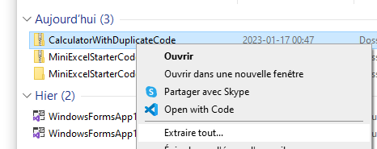
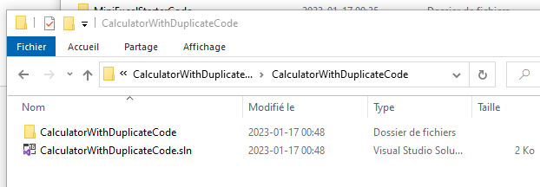
Downloading and Using Course Code
All Code will be prefixed by ‘Code’ in Blackboard
All folders will be .zip files
Click on to download
Open your downloads folder
Right-click and choose ‘extract all’
You can extract right in your downloads folder or pick a new location
If you don’t extract the .zip, Visual Studio won’t be able to open the project
Open the folder, you should see a .sln Visual Studio file and a folder with the files in it.

Slide 4
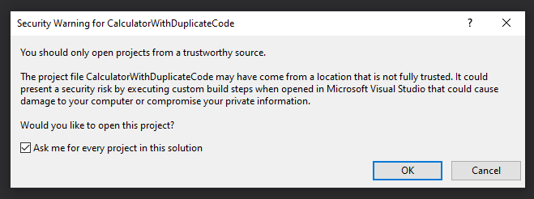
Opening Course Solutions in Visual Studio
Click on the .sln file to open in Visual Studio
There is a security warning. Do NOT open code from untrustworthy sources
If you don’t trust me, don’t run my code in Visual Studio. I won’t be offended.

Slide 5
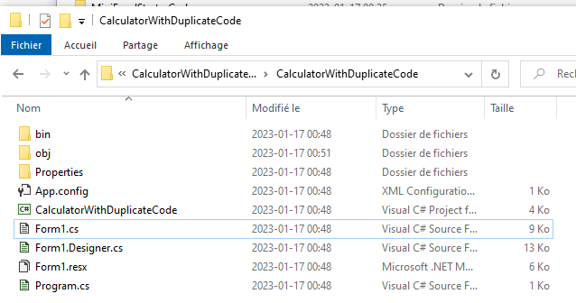
For the Paranoid Security Conscious
You can always look at code in notepad
You can also cut and paste functions or bits of code into a solution that you’ve built yourself
Form1.cs: All your event handlers and custom code
Form1.Designer.cs: Code behind the Form Designer

Slide 6
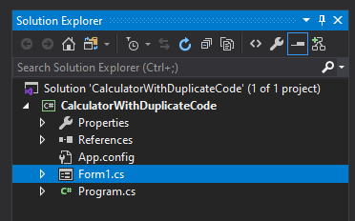
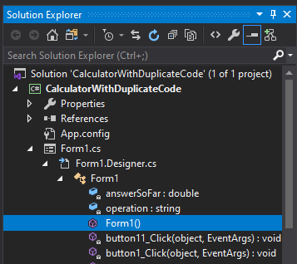
Where is the Code?
When you open the .sln file, it might not open the code or the form designer automatically
To open stuff:
Click Form1.cs (opens Properties)
Click the arrow beside it
Click the arrow beside Form1.Designer.cs
Click the arrow beside Form1
Click Form1() (opens event handler code)
Click Form1 (opens form designer code)
Click Form1.cs (opens form designer)

Slide 7
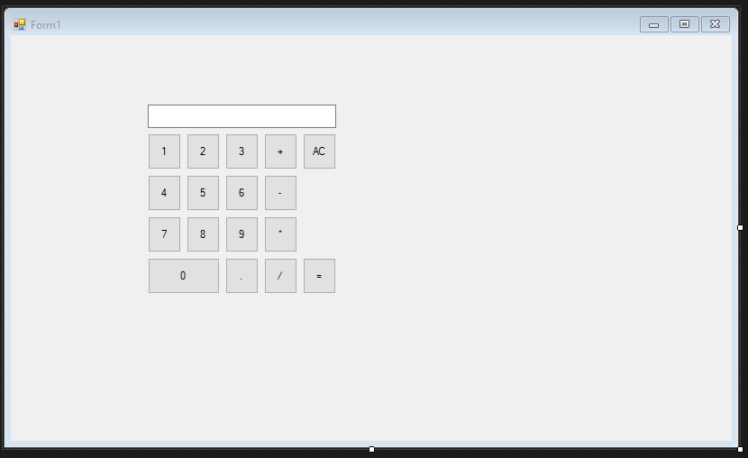
CalculatorWithDuplicateCode
If you open the above solution, you should see a form that looks like the form on the right
Ctrl-F5 to run
The buttons should do what you expect

Slide 8
Duplicate Code
We will look through the event handlers interactively
There is a *lot* of duplicate code
Identical event handlers for the buttons
Not a big deal, the code is one line
Identical event handlers for the operations
This *is* a big deal – this is like 30 lines of code.
Maintenance Nightmare
What if I need to change something about the way buttons are handled?

Slide 9
Calculator With Functions
A separate package that also works, but now has functions
appendToDisplay – add a character to the display textbox
performOperation – depending on the most recent operation, will calculate the new answerSoFar
clearDisplay – empty the display textbox
We can use these functions to write a single function that will handle an operation click
We can then call that function from every operation button handler

Slide 10
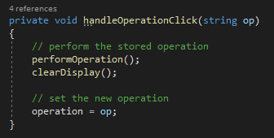
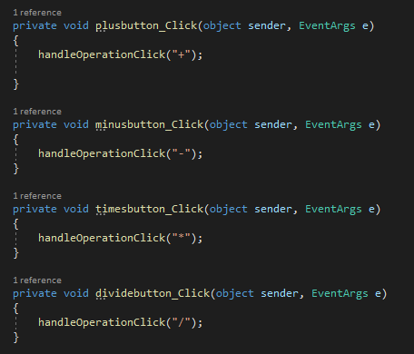
Calculator With Functions
handleOperationClick
When someone clicks an operation like ‘+’
Perform the prior operation
Clear the Display
Set the new operation ‘+’
See attached handlers (right)

Slide 11
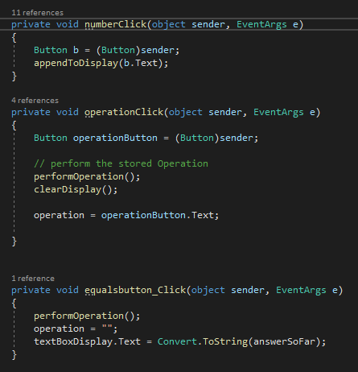
Calculator with Common Events
Same functions as before
Fewer event handlers
One for all numbers
One for all operations
One for the equals button
But how? When I double-click a button it creates something just for that button?

Slide 12
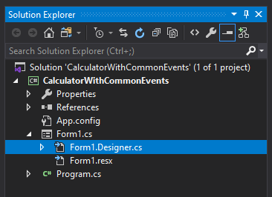
Code Behind the Form Designer
The form designer is just a visual way to build a form
You can do everything with code instead if you want
In fact, the form designer just writes code for you
To see form designer code, click on Form1.Designer.cs in the Solution Explorer

Slide 13
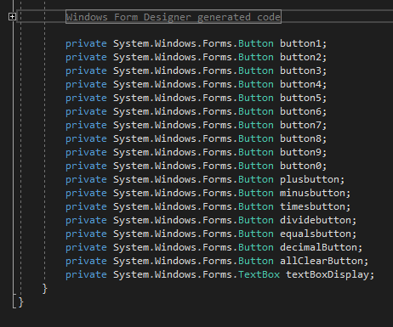
Code Starts Hidden
All I see is the stuff to the right
Click on the + beside the ‘Windows Form Designer generated code

Slide 14
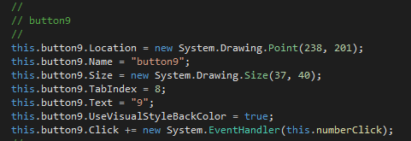
Calculator Button 9 Code
Any property that doesn’t have the default value gets set in code
Location – position of the top left corner in the Form
Size – size of the control
Text – what you’ve changed the text to in the Properties editor
Name – what you’ve changed the name to
Code to associate a specific event handler function with this button

Slide 15
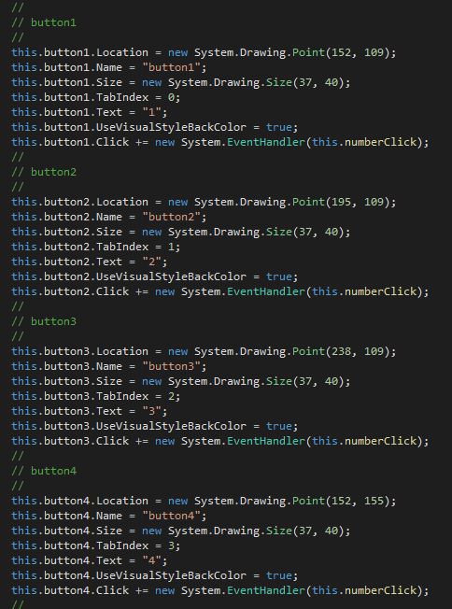
Event Handler for all Buttons
We can add the same event handler to every button (right)
But the buttons are different!

Slide 16
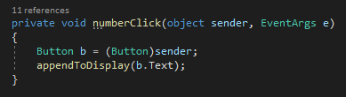
Event Handlers know the Sender
Each event has a source
That source gets sent to the event handler function as the ‘sender’
We know the sender is a button
Button b = (Button) sender
Create a new variable (object) of type ‘Button’, and treat ‘sender’ as a ‘Button’ and assign that to ‘b’
Now we can do Buttony-things to ‘b’, like get b.Text
And call our appendToDisplay function with the text of ‘b’

